Slide 1

Shopping Cart Project
Group D
Magali Fuentes (DataBase)
Diego Gonzales(UI)
Alex Alcala(Controller)
Edgar Quispe(Model)

Slide 2
Agenda
Tools
Pycharm
SourceTree
Python3
PyQt5
Project Structure
MVC
DB model
Diagram of clases
Demo

Slide 3

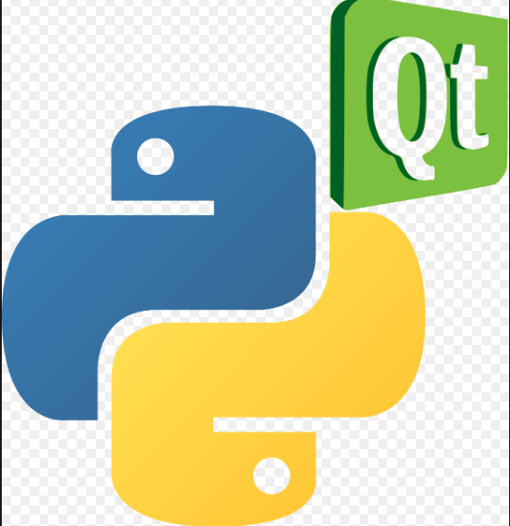
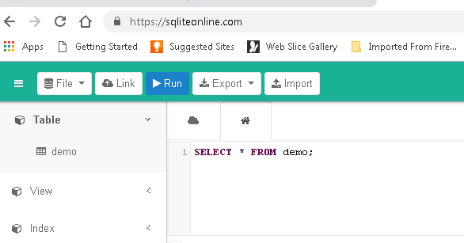
Tools

Slide 4
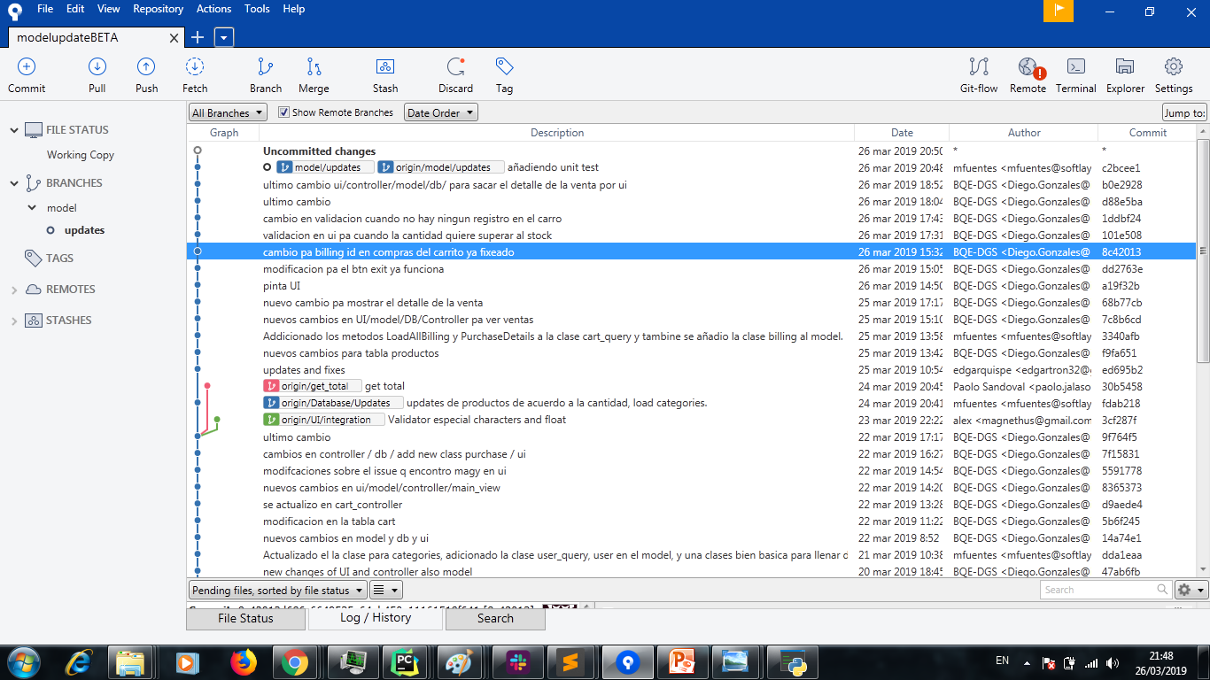
Versioning Tools

Slide 5
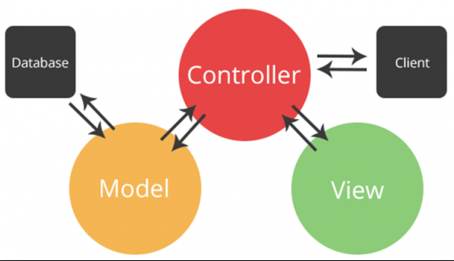
MVC

Slide 6
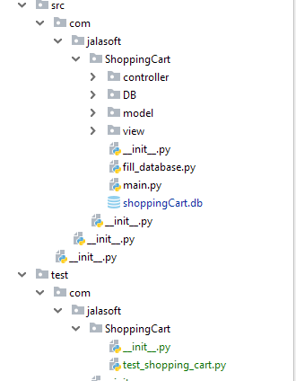
Project Structure
The src directory contains all of the source material for building the project.
The test directory contains the unit test files

Slide 7
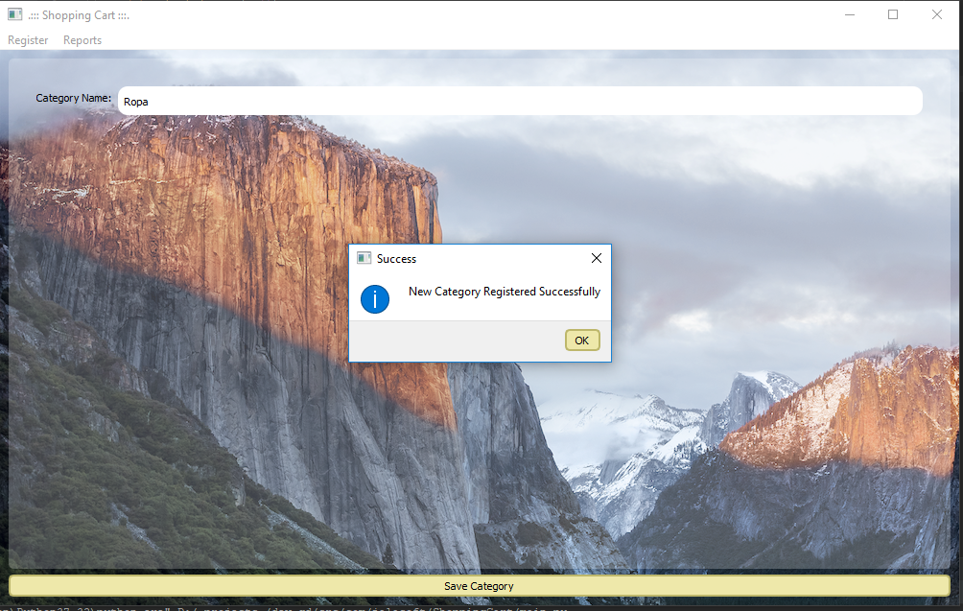
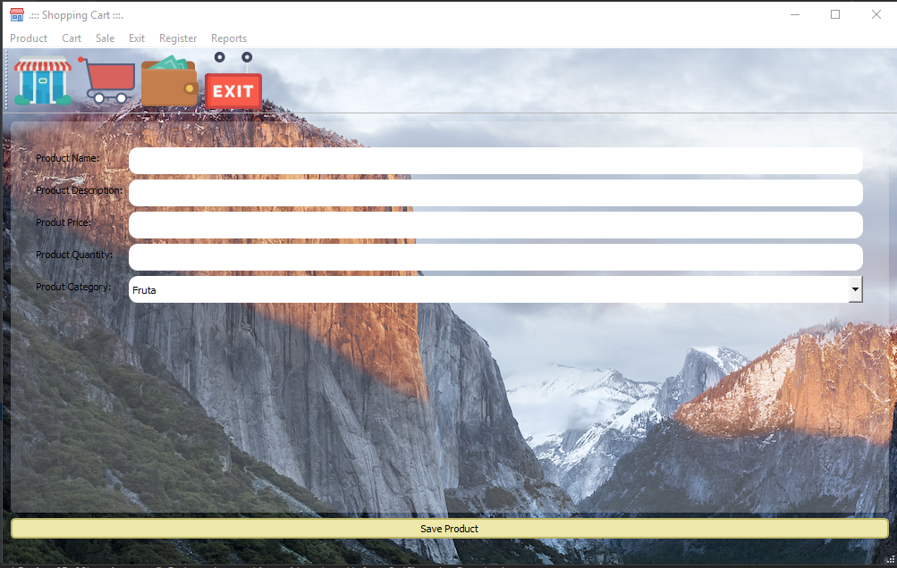
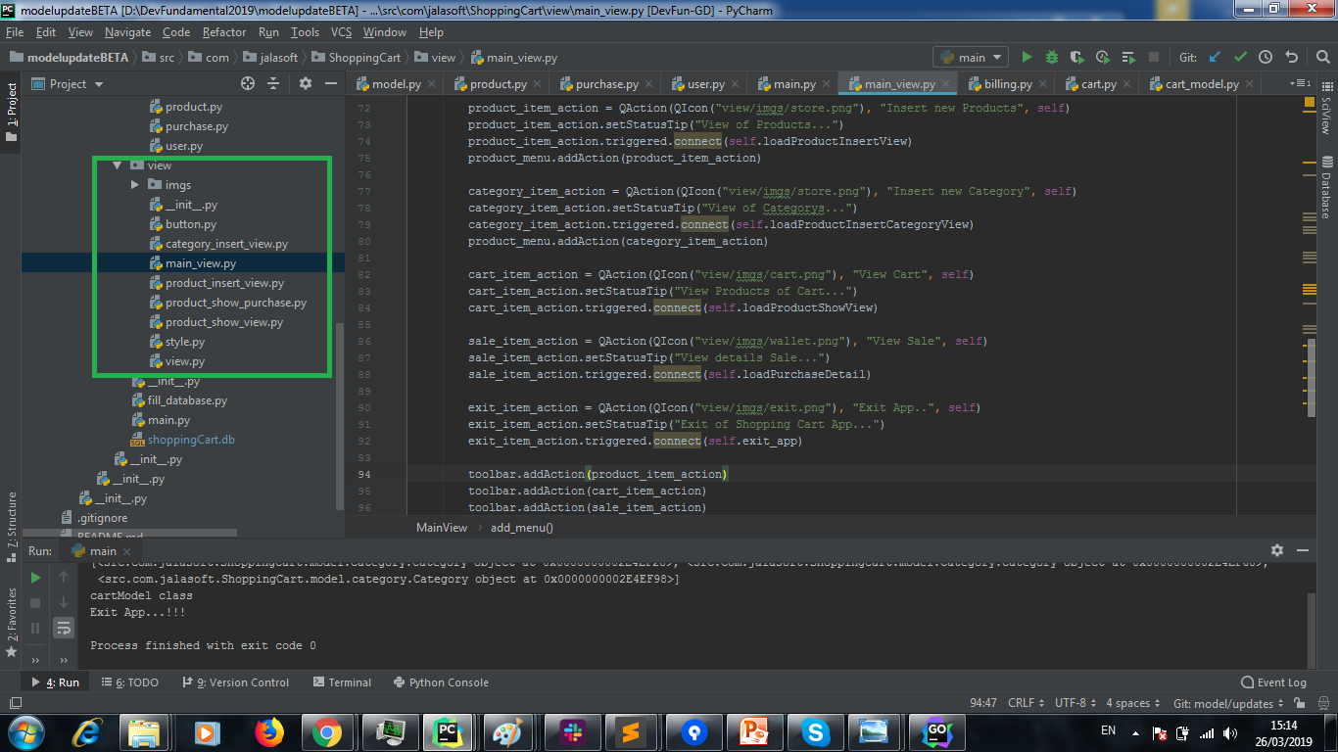
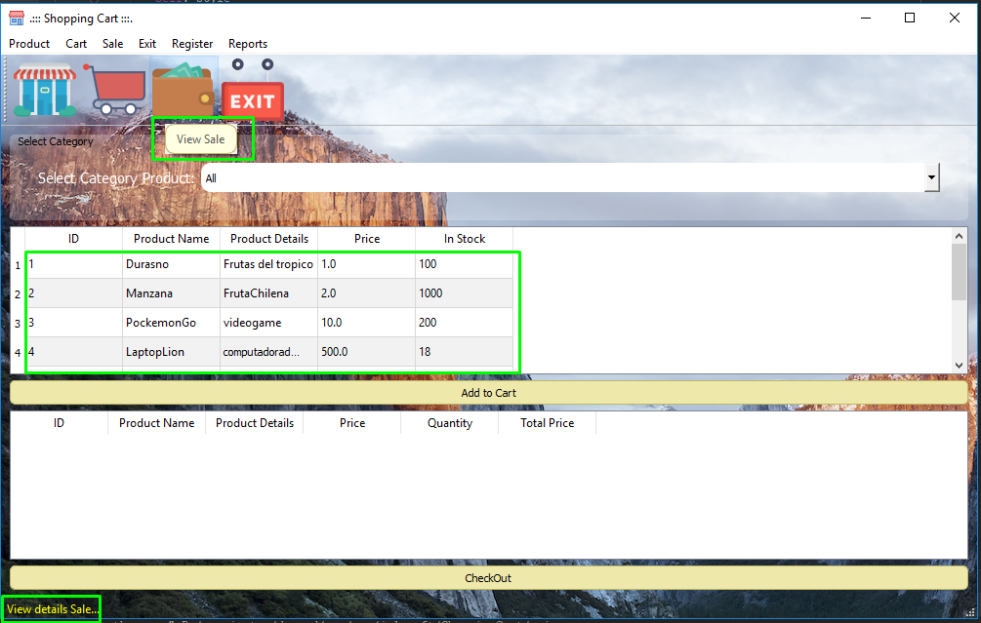
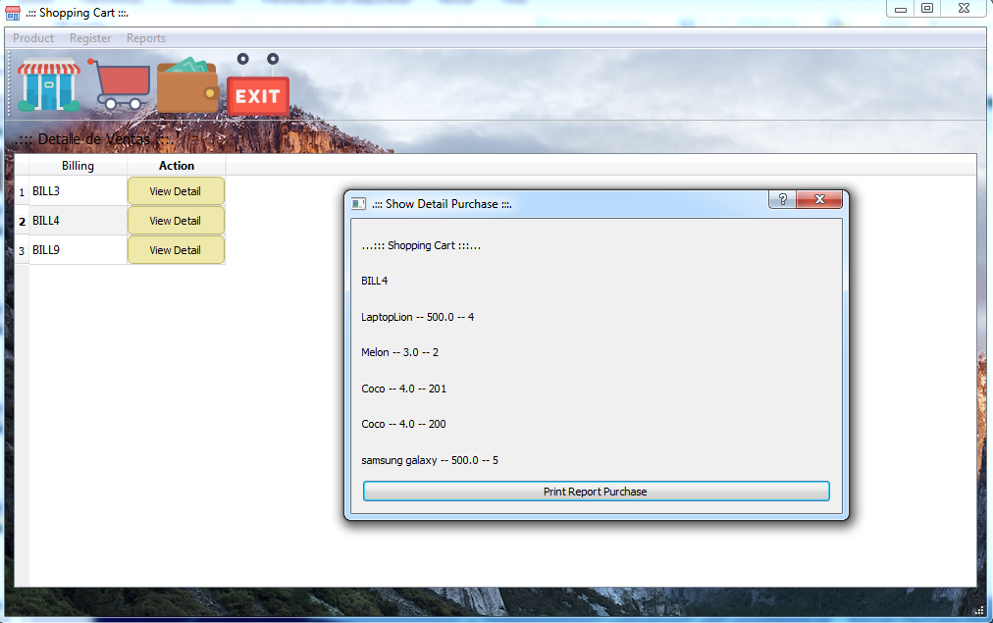
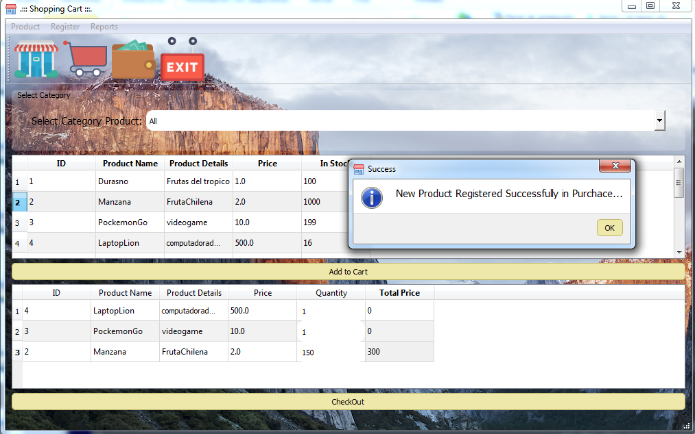
UI

Slide 8
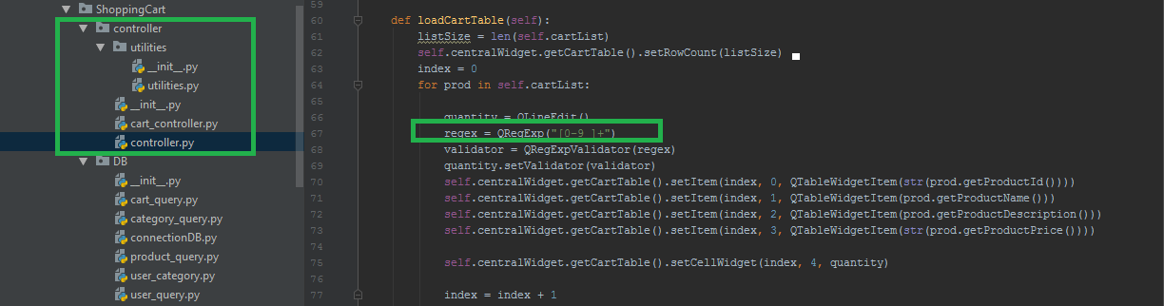
Controller

Slide 9
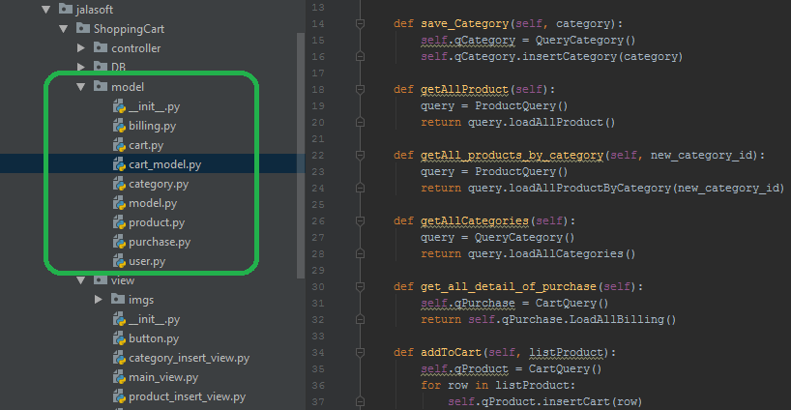
Model

Slide 10
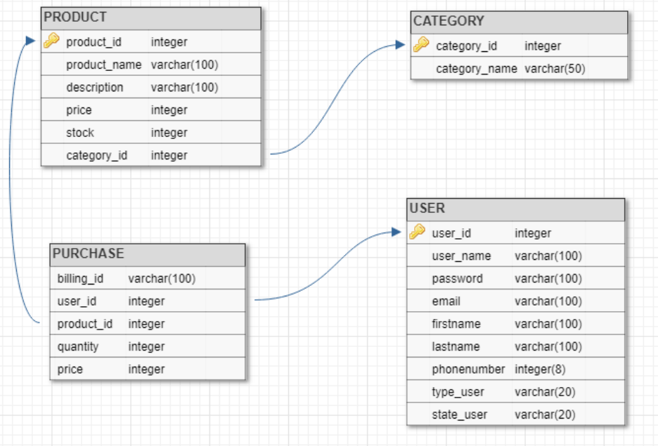
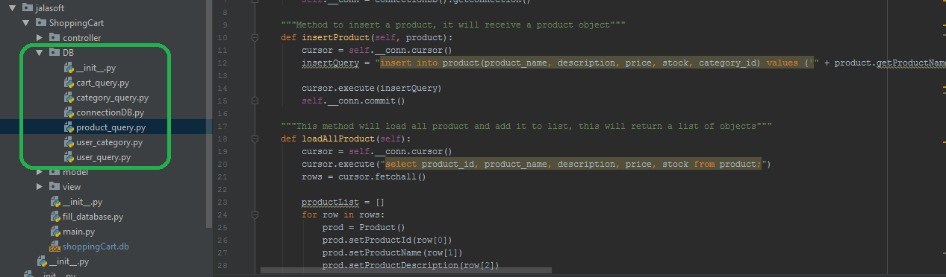
DataBase Model

Slide 11
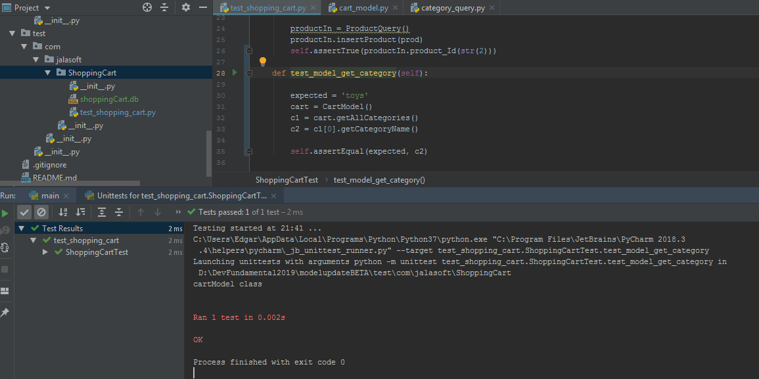
Unit test:

Slide 12
Some Issues:
It is not possible to add product descriptions with spaces (validations issue from controller) (fixed).
It is not possible to updated the product stock on list after click on checkout(UI issue, model, DB issue).
It is not possible to view the billing summary(UI issue).
It is possible to set a quantity greater that product stock on cart list(controller).
It is possible to add the same product to cart more that one time(UI).

Slide 13
Summary:
Lesson learned.
Team work.
Development following MVC.
Integration of individual Development progress.
Fixing issue.
Unit test.
PyQT5.
Versioning with github (we need to continue improving it).

Slide 14
Thanks for your attention.

